Slide 1


PANIMALAR ENGINEERING COLLEGE
DEPARTMENT OF COMPUTER SCIENCE AND ENGINEERING CS8811 PROJECT WORK
UNIVERSITY PROJECT VIVA
TRANSPARENT VOTING SYSTEM
By
Valaparla Akhil Tagore (211418104330),
Mritesh M (211418104324) &
Vengiswaran A L(211418104332)
Dr. M. Rajendiran, M.E., Ph.D.,
Dr. N. Pughazendhi, M.E., Ph.D.,
C10
COORDINATOR:
BATCH NO:
1

Slide 2
Abstract
The AIM of this project isCOVID-19 had a massive impact on human lives. The pandemic lead to the loss of millions and affected the lives of billions of people. Its negative impact was felt by almost all commercial establishments, education, economy, religion, transport, tourism, employment, entertainment, food security and other industries. According to WHO(World Health Organization), 55.6 million people were infected with Coronavirus and 1.34 million people died because of it as of November 2020.
This stands next to black death which almost took the lives of 60 percent of population in Europe in the 14th century. After the person gets infected, it takes almost fourteen days for the virus to grow in the body of its host and affect them and in the meantime, it spreads to almost everyone who is in contact with that person. So, it is extremely hard to keep the track of the spread of COVID-19.

Slide 3
Literature Survey
Title | Description
Samuel Ady Sanjaya, Suryo Adi Rakhmawan. “Face Mask Detection Using MobileNetV2 in The Era of COVID-19 Pandemic” in 2020 International Conference on Data Analytics for Business and Industry: Way Towards a Sustainable Economy (ICDABI) | Corona Virus Disease (COVID-19) pandemic is causing a health crisis. One of the effective methods against the virus is wearing a face mask. This paper introduces face mask detection that can be used by the authorities to make mitigation, evaluation, prevention, and action planning against COVID-19.
V Nithyashree, S Roopashree, Aparna Duvvuri, L Vanishree, Disha Anand Madival, G Vidyashree. “A Solution to Covid-19: Detection and Recognition of Faces with Mask” in 2021 International Conference on Intelligent Technologies (CONIT) on 27 june 2021 | In this COVID-19 crisis, wearing masks is necessary and no longer an option to the general public. To follow the strict directives given by the government, the businesses have to implement a cost-effective approach to ensure that all its employers wear a face mask and help to control the spread of coronavirus.

Slide 4
Problem Statement
Many people are not wearing the on this covid crisis , there are some places were mask protection is compulsory with government rules.
In some software that is already existed ,it can detect only single person at a time
Cannot fetch more number of peoples detail
It cannot shows the perfect wearing percentage of the mask

Slide 5
EXISTING SYSTEM
The existing systems are also not robust in detecting face masks on a human face, as the characteristics of the diseases vary in terms of time due to changes in climate, geographical, and biological aspects. Many of the current techniques are computer vision-based models, which are less accurate and efficient. The discussed limitations have been overcome to enhance the performance of face mask detection models successfully in the presented application. The existing models cause unsatisfactory results & excessive trouble to the general public and authorities.
PROPOSED SYSTEM
DL allows for analyzing and interpreting massive volumes of data in a fast and accurate way. We propose to use MobileNetV2 architecture to ensure accurate face-mask detection. The proposed approach provides accurate detection of face mask-wearing and whether it is worn in an appropriate way or not in real-time. The first stage is Pre-processing. Images in the training dataset are subjected to Pre-processing to avoid false predictions and to enhance the quality of images. Live capture of multimedia impressions is used for detailed analysis and predictions. To do this, a complete dataset is created after Image de-Colorization and contouring, hence the dataset is very pure.

Slide 6
System requirements
HARDWARE REQUIREMENTS
Processor : Intel Core i5 3.29GHz
Hard disk : 1 TB
RAM : 16 GB
Keyboard : 110 keys enhanced
SOFTWARE REQUIREMENTS
Operating system : Windows7 (with service pack 1), 8, 8.1 and 10
IDE : Anaconda 2.0
Language : Python

Slide 7
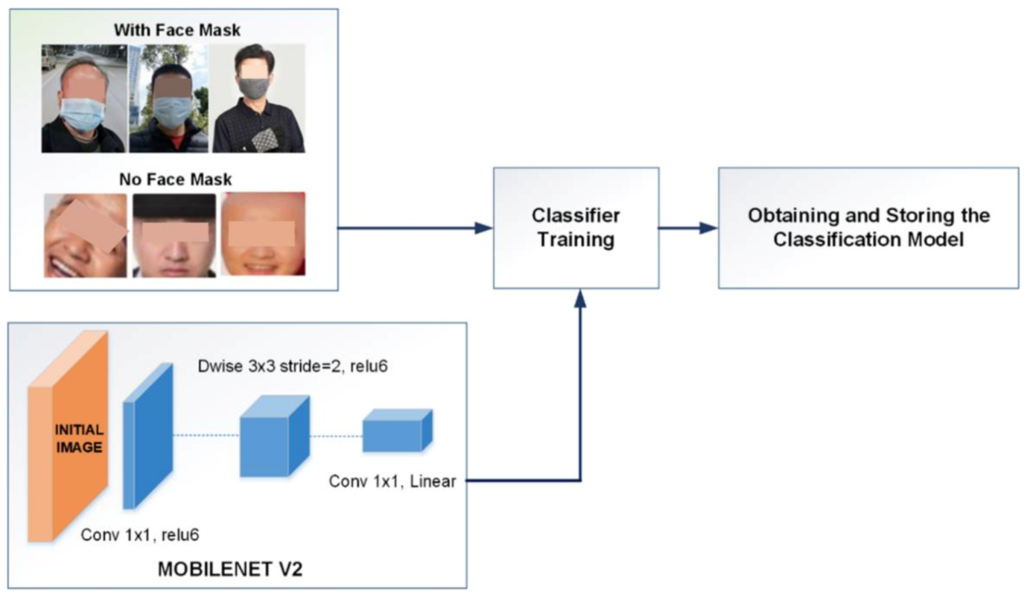
SYSTEM ARCHITECTURE

Slide 8
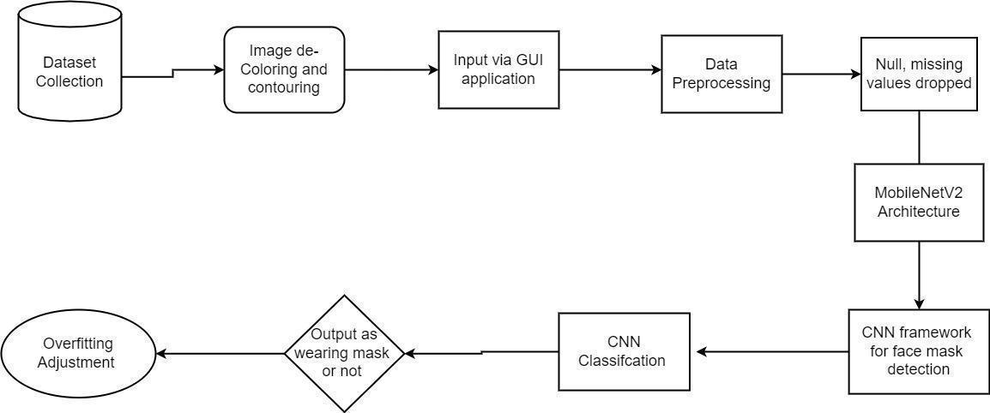
FLOW CHART

Slide 9
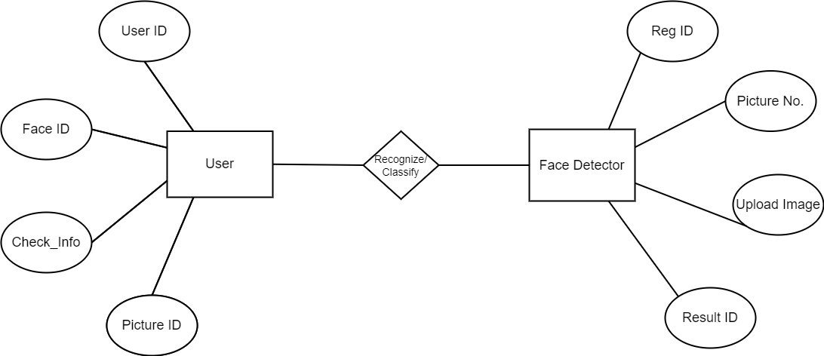
ER DIAGRAM

Slide 10
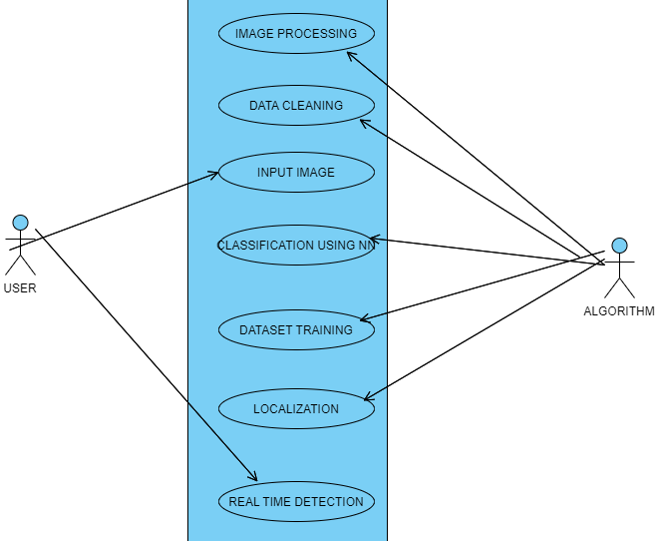
USE CASE DIAGRAM

Slide 11
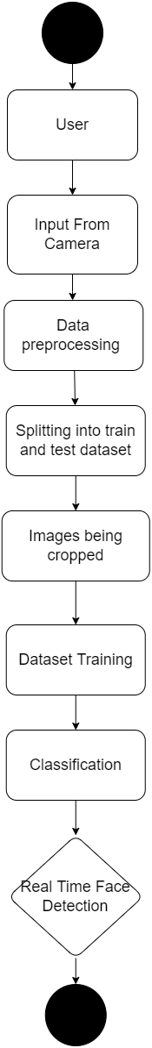
ACTIVITY DIAGRAM

Slide 12
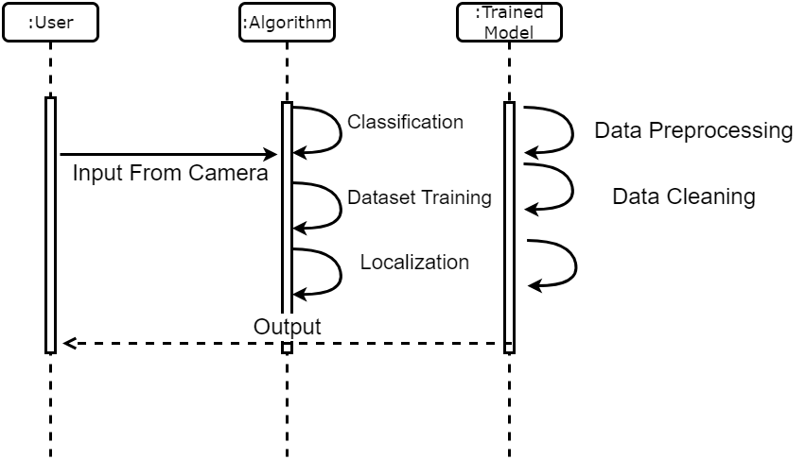
SEQUENCE DIAGRAM

Slide 13
MODULE DESCRIPTION
GUI AND DATA PREPROCESSING
The gathering of datasets for face mask detection was done through continuous image de-colouration and contouring, hence the dataset is very pure. In many cases, the main module is the input module where the data are implemented, in this module the data can be directly added via GUI and through an endpoint connection which can be able to produce the output. The GUI application is built in python. Face mask detection refers to detecting faces in the image and then classifying each face as with a mask or without a mask. The process begins with preprocessing of the given data from a large dataset. The data is cleaned and pre-processed at this stage, where missing and null value records are dropped. In our dataset, we cleaned all the null values and checked whether all the data types are valid. The main purpose of preprocessing is to identify and drop or substitute the missing values in the dataset which occupy a very small part of the whole data, to ensure an accurate result.

Slide 14
TRAINING NEURAL NETWORKS
MobileNetV2 is an architecture of bottleneck depth separable convolution building of basic blocks with residuals. We propose to use MobileNetV2 architecture to ensure accurate face-mask detection, the proposed CNN architecture. We choose to use MobileNetV2 since it provides several advantages such as: it is a light-weight DL suited to edge devices,
it provides excellent results for object detection, and
it can efficiently tradeoff between accuracy and latency using simple global hyperparameters.
The most amazing thing about this approach is that it actually works remarkably well. They tend to work best when all the features are at least, well, relevant, because the number of features selected for a particular tree is small.

Slide 15
CLASSIFICATION AND OUTPUT
The MobilenetV2 architecture is used as a foundation for the classifier to perform real-time mask identification. Since MobileNet v2 outperforms other state of art methods in predicting outcomes accurately, it is used efficiently in this model. Then the proposed CNN classifies faces with and without masks as the output layer of the proposed CNN architecture. It saves the best model with the highest accuracy. Finally, the saved model can be used in the real world. The name of this phase is model evaluation. Overfitting when any classification parameter like with mask and without mask needs to be adjusted, it is necessary to have a training dataset apart from training and testing datasets. Web and desktop apps can use the live video feed for detection. The program can also be linked to the entrance gates, allowing only those who are wearing masks to enter. It can also be used in shopping malls and universities.

Slide 16
TESTING
S No | Test Cases | Expected Output | Actual Output | Status
1. | Loading dataset for Training | The dataset should be trained | Dataset is trained | PASS
2. | Loading the CNN model | The model should be loaded for training the dataset | The model has been loaded successfully | PASS
3. | Training the model | The model should be trained as per the conditions | The model has been trained | PASS
4. | Inserting the input image | The input image should be successfully uploaded for further process | The input image has been uploaded | PASS

Slide 17
5. | Pre-processing the input image | Pre-process the image to reduce distortion and enhance the image for further processing | Displays the pre-processed image | PASS
6. | Classification - Normal | It should display the message as “Mask with percent” | Displays the message as “mask with percent” | PASS
7. | Classification - Tuberculosis | It should display the message as “no mask” and display the Segmented image | Displays the message as “no mask” and segmented image | PASS

Slide 18
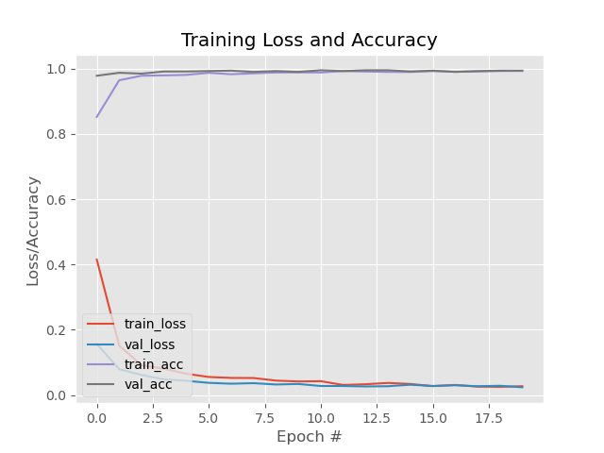
RESULTS
TRAINING LOSS AND ACCURACY DETECTION

Slide 19
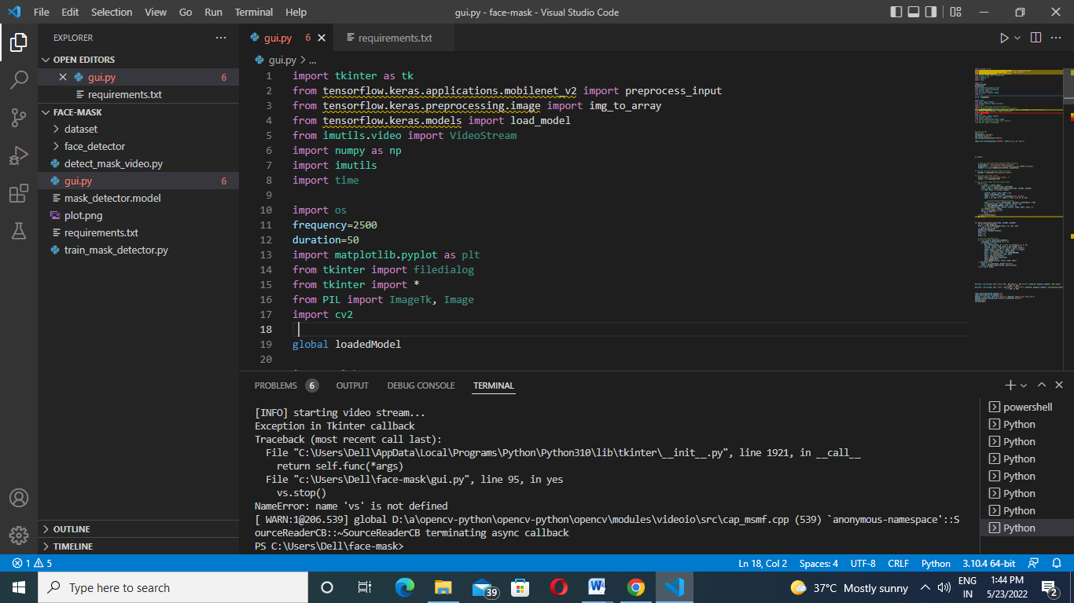
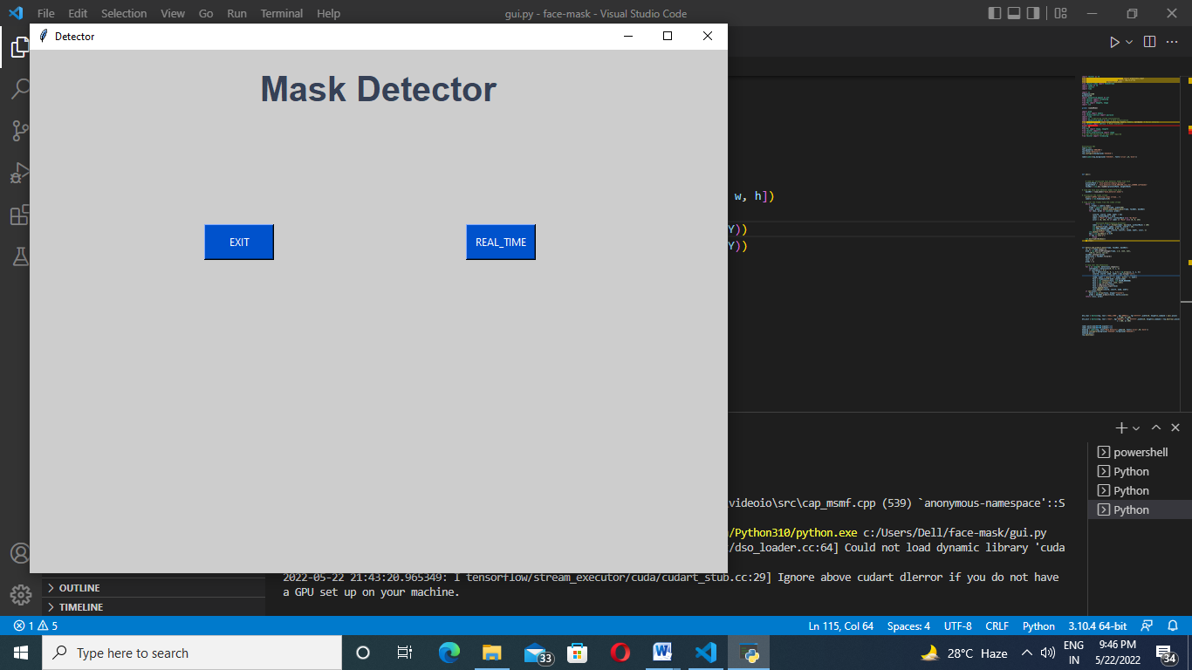
SCREENSHOTS
EXECUTION OF PROGRAM
UI interface of face mask detection click real time

Slide 20
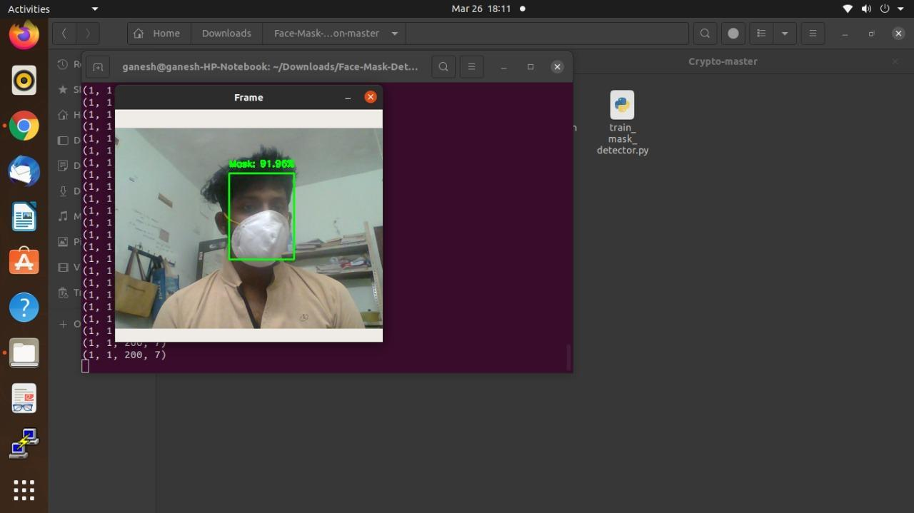
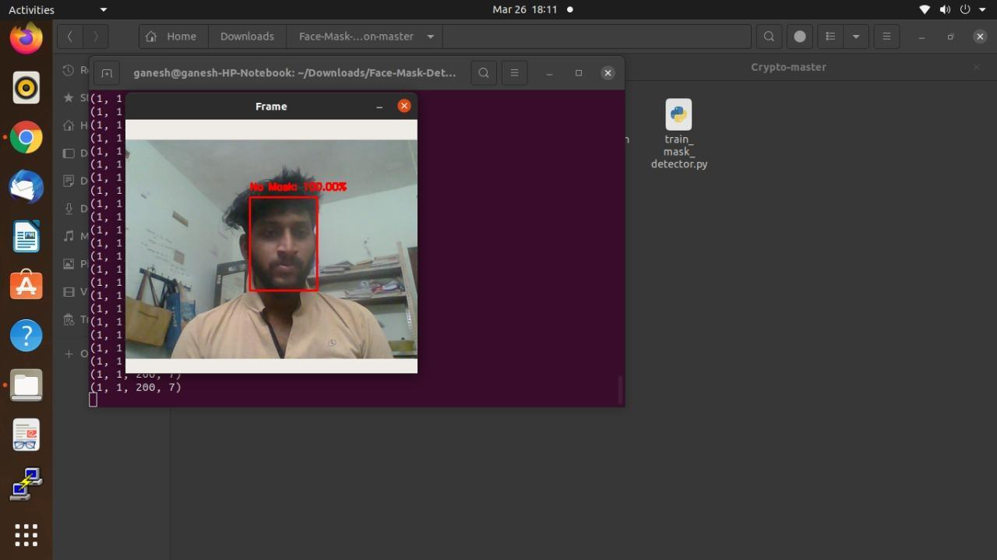
SINGLE FACE MASK DETECTION
NO FACE MASK FOUND

Slide 21
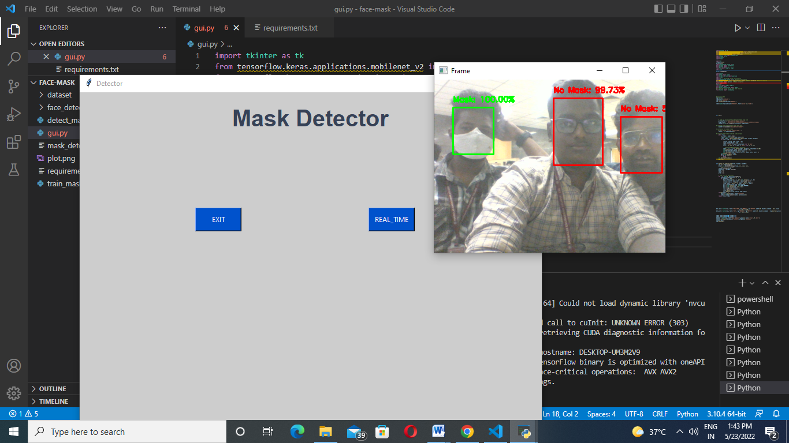
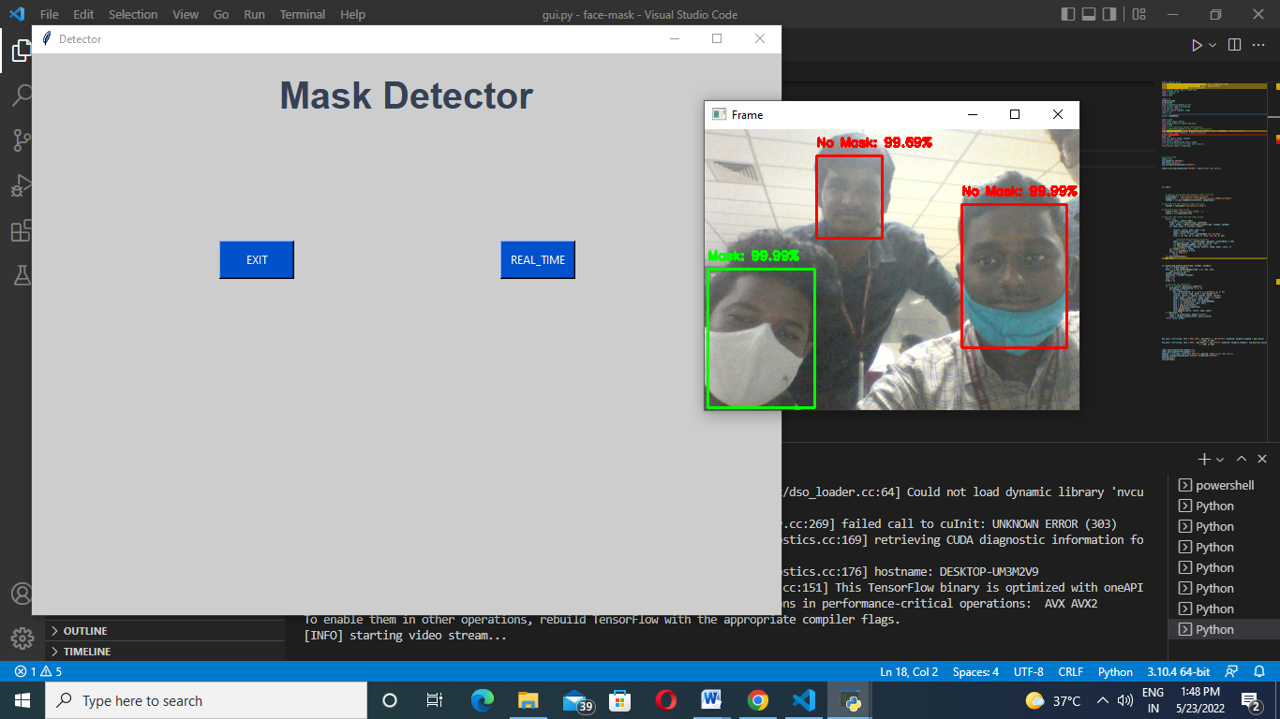
MULTI FACE MASK FOUND
HALF FACE MASK WEARING DETECTION

Slide 22
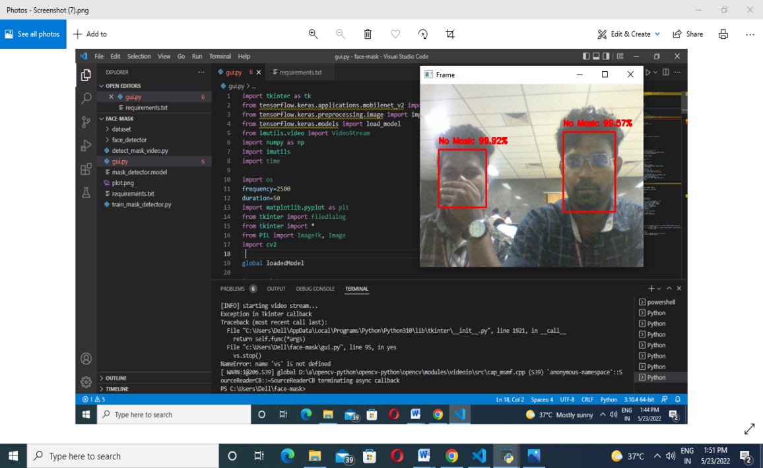
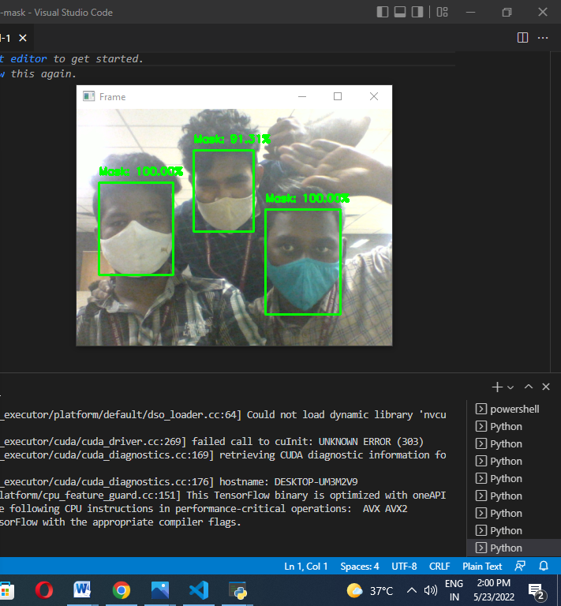
SHOWING NO MASK WHEN FACE IS COVERED WITH HAND
FACE DETECTION WHEN EVERYONE WEARS MASK

Slide 23
CONCLUSION
Human faces are different for different people on the basis of various parameters. The uniqueness and measurement of the different parameters help us to recognize the persons. In summary, the state-of-the-art methods for human face recognition have already achieved a high accuracy rate which led to its practical applications.However, it cannot be denied that using the existing method poses many challenges, mainly slow functioning, and inefficiency.Due to the vital importance of developing an intelligent surveillance system to detect and identify human faces, we presented a fast and robust approach that can immediately
The proposed framework is not only much faster than the previous work but also maintains competitive accuracy with the state-of-the-art human detection system.It is independent of the user's physical interaction.

Slide 24
REFERENCES
[1] Samuel Ady Sanjaya, Suryo Adi Rakhmawan. “Face Mask Detection Using MobileNetV2 in The Era of COVID-19 Pandemic” in 2020 International Conference on Data Analytics for Business and Industry: Way Towards a Sustainable Economy (ICDABI)
[] V Nithyashree, S Roopashree, Aparna Duvvuri, L Vanishree, Disha Anand Madival, G Vidyashree. “A Solution to Covid-19: Detection and Recognition of Faces with Mask” in 2021 International Conference on Intelligent Technologies (CONIT)on 27 june 2021

Slide 25

PLAGIARISM REPORT

Slide 26
THANK YOU

